Slide 1



Digital
Games
Game Design - 201
Tue 2-4:45pm C-356
Prof. Alec McClure

Slide 2
Last week

Slide 3
Peer Evaluations
http://goo.gl/forms/bvTRFNtX6C

Slide 4
Polished Games?
15 mins

Slide 5
traditional platformers

Slide 6
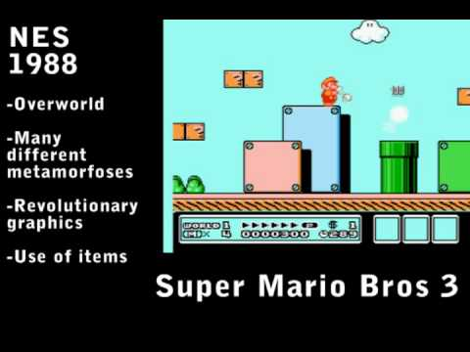

Slide 7
non-traditional platformers

Slide 8
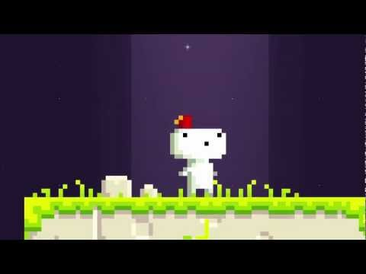
example 1
fez
Notes:
theme: screen rotation mechanic
Fez is a two-dimensional (2D) puzzle platform game set in a three-dimensional(3D) world. The player-character Gomez lives peacefully on a 2D plane until he receives a red fez and witnesses the breakup of a giant, golden hexahedron that tears the fabric of spacetime and reveals a third dimension. After the game appears to glitch, reset, and reboot,^{[4]} the player can rotate between four 2D views of the 3D world, as four sides around a cube-like space.^{[1][5]} This rotation mechanic reveals new paths through thelevels by connecting otherwise inaccessible platforms, and is the basis of Fez‍‍ '​‍s puzzles.^{[6]}

Slide 9
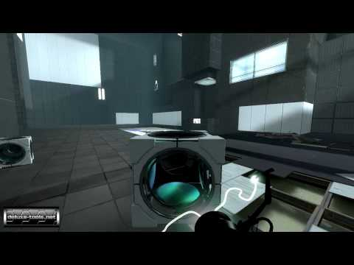
example 2
portal
Notes:
theme: wormholes

Slide 10
example 3
entire screen of one game by @tom7
http://entire.spacebar.org/
Notes:
theme: recursion

Slide 11

example 4
Circa Infinity
Notes:
theme: wormholes

Slide 12
space and dimensionality

Slide 13
GAME 2 - DIMENSION EXPLORER REQUIREMENTS
Space / Time / Dimensionality must be fundamental to game concept
ALL CORE MECHANIC(S) MUST BE ORIGINAL
If Mario or Sonic did it, you can’t.
Individuals or teams up to 3 members
Teams of more than 1 must use Unity, unless granted special exception
Solo teams can use Unity, GameMaker or Processing

Slide 14


Slide 15
break into teams
1-3 members

Slide 16
brainstormin’
Write down 5 characters and 5 situations without saying anything out loud.
e.g.
a mortician
waiting in line at the post office

Slide 17
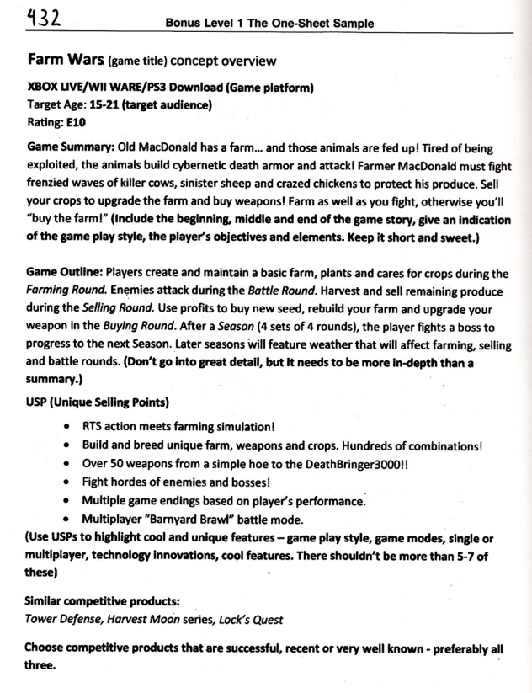
One-Sheet Example
link

Slide 18
One-Sheet Outline
Title
Game Platform
Target Audience
Rating
Game Summary
Game Outline
USP (Unique Selling Points)
Similar Competitive Products / Precedents
Notes:
you might not know everything for the pitch, which is OK.
this is a market based approach. feel free

Slide 19
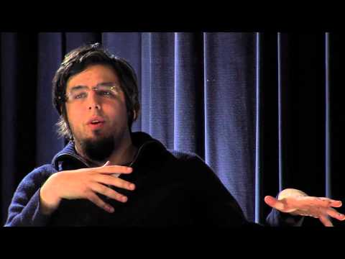

Slide 20
HOMEWORK
Platformer Pitches -- next week
One-sheets for all
Formal presentation with sketches, inspiration/precedent visuals, etc.

